Slide 1


Carb
Capture
Nassim, Cornelius, Jiaxing, Cole

Slide 2
Agenda
Objective
Problem Statement
Solution
User Information
Documentation
Interfaces
Conclusion
1.
2.
3.
4.
5.
6.
7.

Slide 3

Objective
+Develop a user-friendly application to help people manage diabetes
+Provide accurate carbohydrate estimation through AI-based food image analysis
+Enable personalization catered to each user
-Blood-Glucose Target Level
+Dexcom Integration
+Offer seamless integration with Dexcom API for real-time glucose monitoring and tracking
+Create system for logging and analyzing nutritional data
Make managing diabetes safer, more efficient, and easier

Slide 4
Agenda
Objective
Problem Statement
Solution
User Information
Documentation
Interfaces
Conclusion
1.
2.
3.
4.
5.
6.
7.

Slide 5
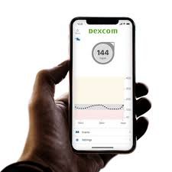
Problem Statement
Managing diabetes requires balancing blood sugar levels, insulin dosage, and food intake, which can be overwhelming and error-prone, especially with meals of unknown nutritional content.
Even though CGM devices like Dexcom provide real-time glucose readings, there is a need for an app that integrates this data with carbohydrate estimations to assist in precise insulin dosage calculations.

Slide 6
Agenda
Objective
Problem Statement
Solution
User Information
Documentation
Interfaces
Conclusion
1.
2.
3.
4.
5.
6.
7.

Slide 7
Solution
Carb Capture: offers meal recognition through photos with real-time glucose data from Dexcom devices to calculate precise insulin dosages.
Users can upload meal photos for accurate carb estimation, set a target glucose range for personalized recommendations, and track food intake and glucose levels to identify patterns and improve treatment plans.
By reducing guesswork and simplifying daily diabetes care, Carb Capture helps users achieve better glycemic control and overall health outcomes.

Slide 8
Agenda
Objective
Problem Statement
Solution
User Information
Documentation
Interfaces
Conclusion
1.
2.
3.
4.
5.
6.
7.

Slide 9
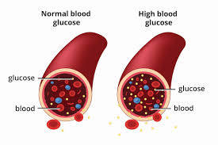
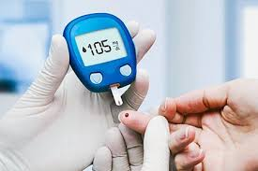
User Information
Primary Users
+Targeted at individuals with diabetes
-Type 1 & insulin-dependent Type 2 diabetics
+Approximately 2 million people in the U.S. with Type 1
-A 10% adoption rate could yield a user base of 200,000
+Inclusive design for all age groups and technical skill levels
-Requires basic smartphone skills, like downloading and navigating applications
+No training is required, optional app tutorial or healthcare provider tutorial can be provided in the future

Slide 10


User Information
Environment
+Compatible with Android and iOS devices
+Optimized for casual, daily use during meals at home, work, or out and about
+Runs on smartphones and tablets, requiring minimal hardware and recent software updates
+Prioritizes reliable health estimates and user-friendly functionality

Slide 11

User Information
Privacy
+No private health information stored; carb estimates are processed locally
+User data is independent and remains on the user’s device
+No sensitive data integration
+Minimal cybersecurity risks, we plan to address concerns if features like logging systems, healthcare provider integration, or other sensitive features are added

Slide 12
Agenda
Objective
Problem Statement
Solution
User Information
Documentation
Interfaces
Conclusion
1.
2.
3.
4.
5.
6.
7.

Slide 13
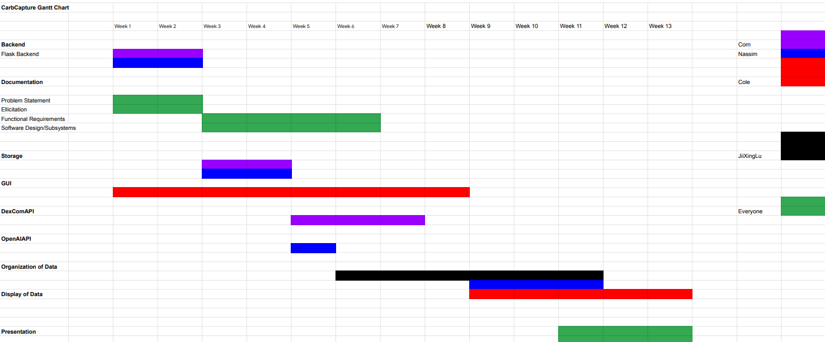
Documentation
Gantt Chart

Slide 14
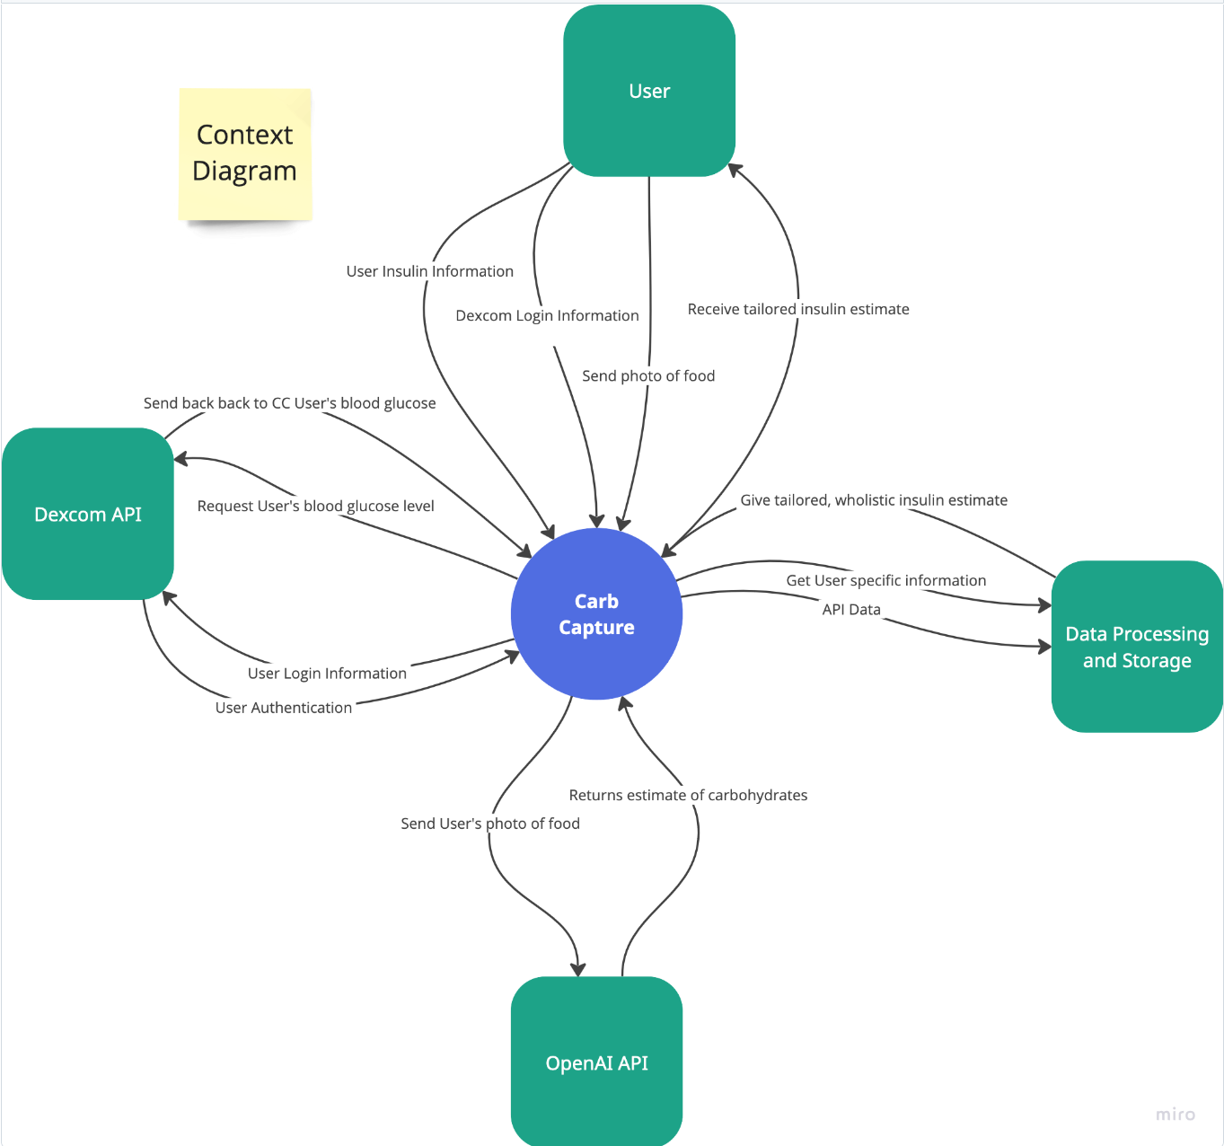
Documentation
Context Diagram
Components: Dexcom API, OpenAI API, User, Data Processing/Storage, Carb Capture Application
Highlights several software interactions to provide a functional, simple Carb Capture application to users
The application is the heart of operations, utilizing user input and external data

Slide 15
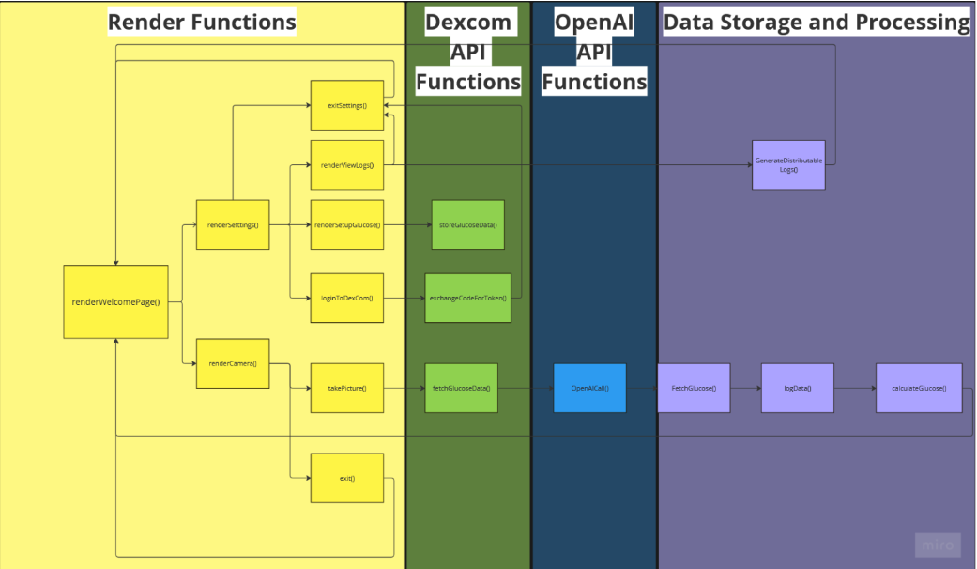
Documentation
Software Architecture
Rendering: Defines UI rendering functions using React
Dexcom API: Responsible for communicating with Dexcom API
OpenAI: Responsible for integrating OpenAI API to process data
Data Storage & Processing: Functions handling data storage and backend processing

Slide 16
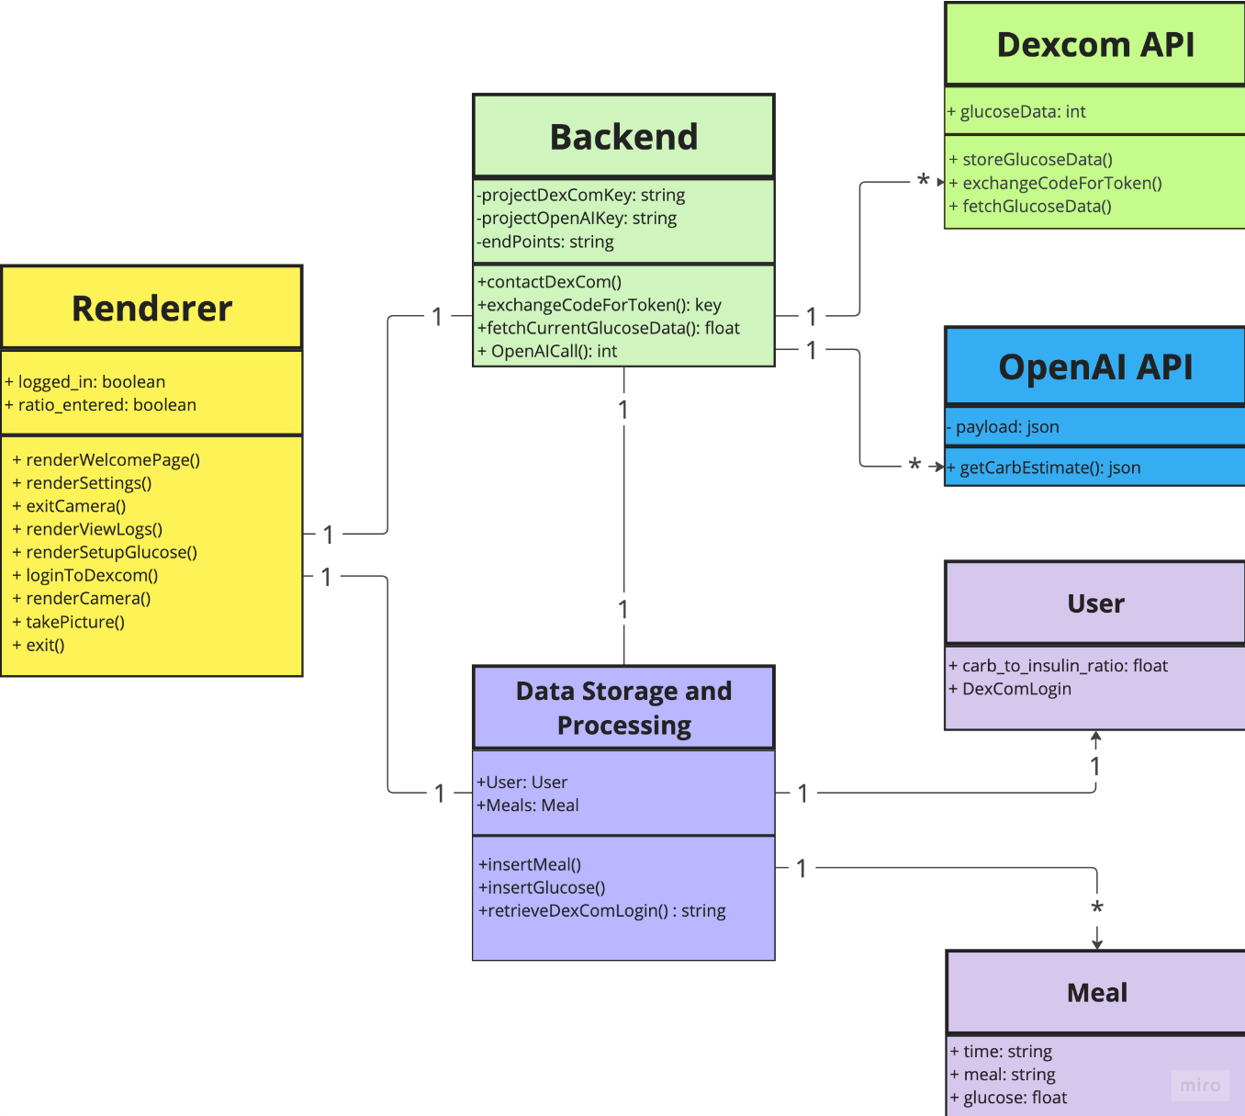
Documentation
UML Diagram
High-level architecture diagram showing interactions between software components and their relationships
+User interaction with Renderer
+Renderer interaction with Backend
+Backend interaction with API’s
+Backend processes meal data and calculates carb-to-insulin ratio

Slide 17
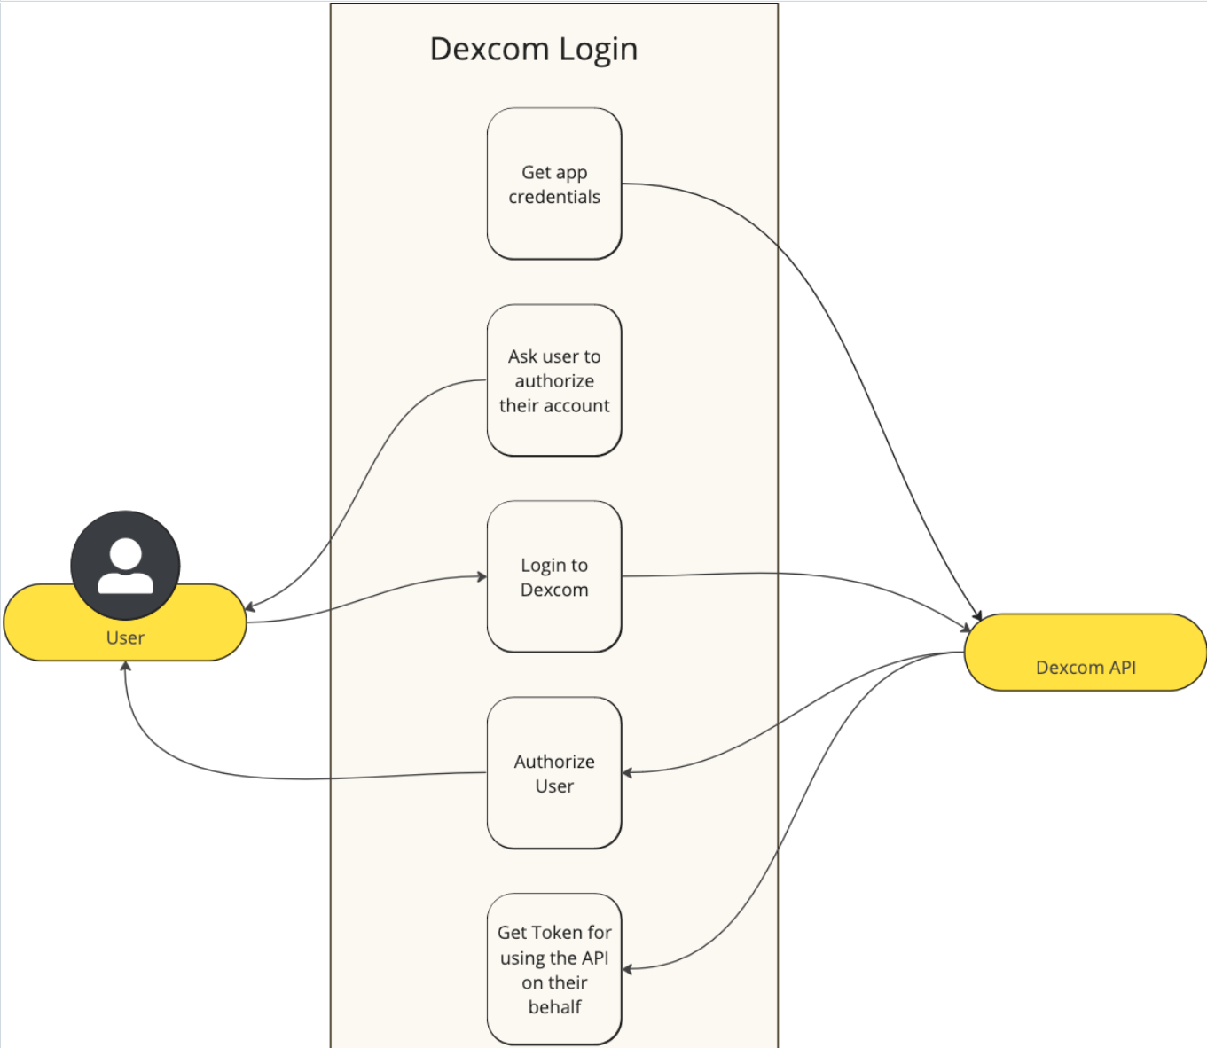
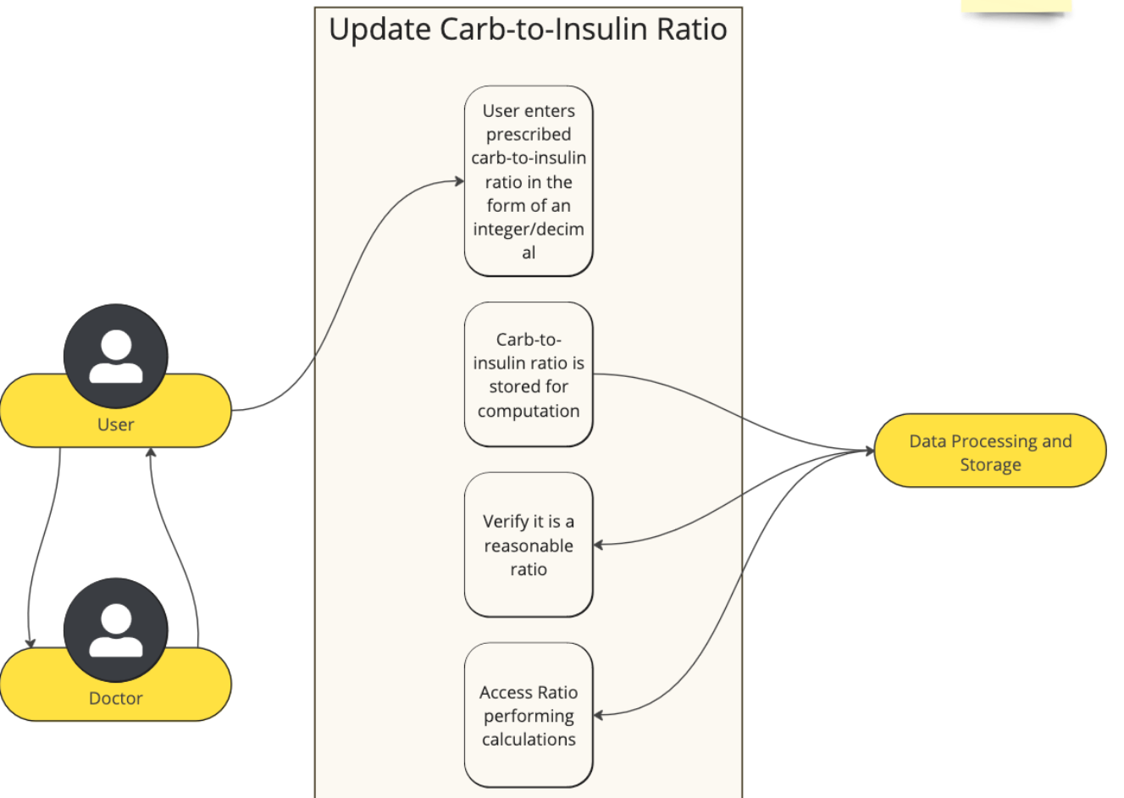
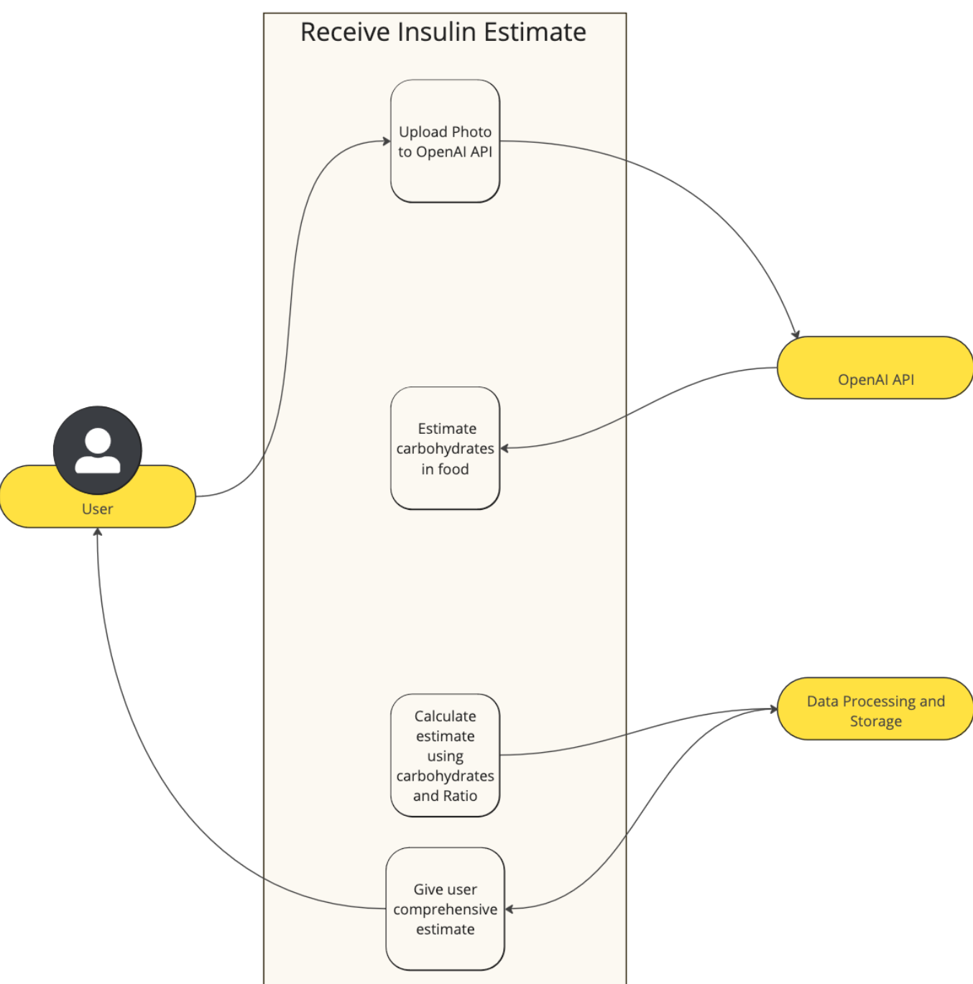
Documentation
Use Cases
Additional Use Cases:
Track Blood Glucose Trends, Generate Nutritional Reports, Uploading Food Photos

Slide 18
Agenda
Objective
Problem Statement
Solution
User Information
Documentation
Interfaces
Conclusion
1.
2.
3.
4.
5.
6.
7.

Slide 19

Interfaces
Opening the App
+First time opening the app
+Options for Dexcom connections + target blood-glucose ratio
+In depth explanation of each step
+User friendly

Slide 20
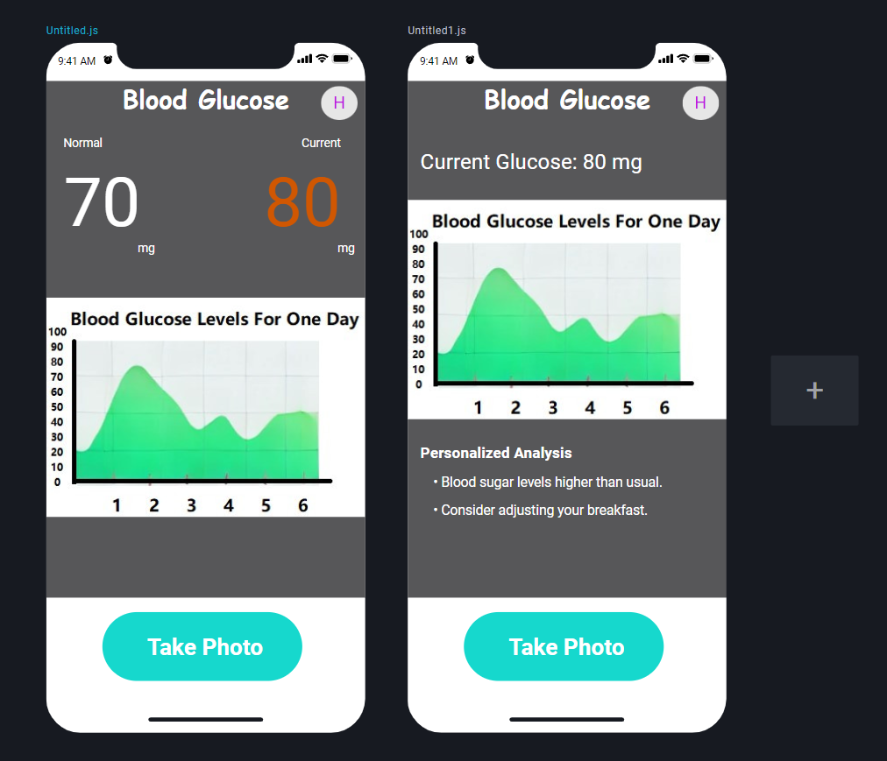
Interfaces
Home Page
+Centralized graph to track daily blood-glucose levels
+Large ‘Take Photo’ button to showcase key app purpose
+User icon in top right corner, can be used to access settings
+Displays current glucose reading and target glucose level

Slide 21
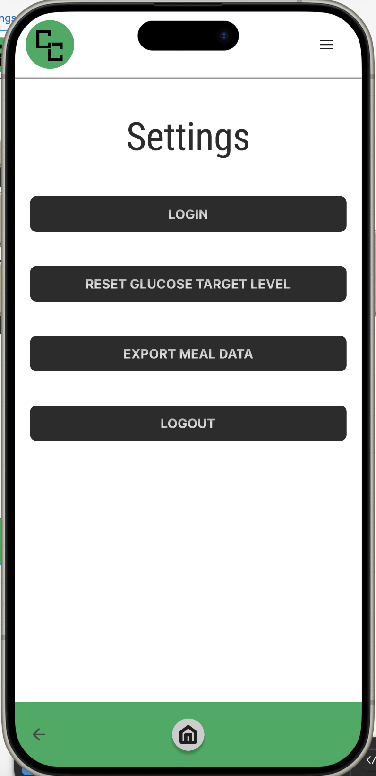
Interfaces
Settings Page
Login: option to return to the Dexcom login page if user connection is separated
Reset Glucose Target Level: option to return to the ‘Set Target Glucose Level’ page incase a user entered incorrect data or has updated health information
Export Meal Data: user has the ability to export meal data in a certain format for a specific period of time
Logout: logs the user out of Dexcom connection

Slide 22
Agenda
Objective
Problem Statement
Solution
User Information
Documentation
Interfaces
Conclusion
1.
2.
3.
4.
5.
6.
7.

Slide 23
Conclusion
Possible Updates & Expansion
+Offline Data Logging: Log data offline, sync later
+Multiple User Profiles: Manage profiles for dependents
+Custom Meal Suggestions: Tailored meal recommendations
+Blood Glucose Alerts: Real-time glucose level notifications
+Integration with Devices: Sync with Fitbit and Apple Watch
+Educational Content: Diabetes tips and resource libraries
+Cloud Backup & Portability: Secure multi-device data storage
+Integration with Insulin Pump: Automate insulin dose calculations
+Improved AI: Better accuracy for wider food ranges, broader compatibility with services

Slide 24

Conclusion
Summary
+Carb Capture integrates AI, real-time data, and user-friendly interfaces to help manage blood glucose and insulin needs
+Stores user inputs, such as carb-to-insulin ratios and meal logs, securely for accurate recommendations
+Supports meal photo analysis, insulin recommendations, glucose trend tracking, and generating nutritional logs

Slide 25
Conclusion
Backend, Frontend, & Demo
Questions?

